Slide 1

Spark Introduction
Spark Intro
Spark Use Cases
Spark and Hadoop
Running Spark
Spark 3
Hands on With Spark
Copyright © 2022 by Elephant Scale, All Rights Reserved

Slide 2
Objectives
Learn about Spark ecosystem
Understand Spark use cases
Installing and running Spark
Using Spark Shell
Copyright © 2022 by Elephant Scale, All Rights Reserved

Slide 3
Spark Intro
Spark Intro Spark Use Cases Spark and Hadoop Running Spark Spark 3 Hands on With Spark
Copyright © 2022 by Elephant Scale, All Rights Reserved

Slide 4

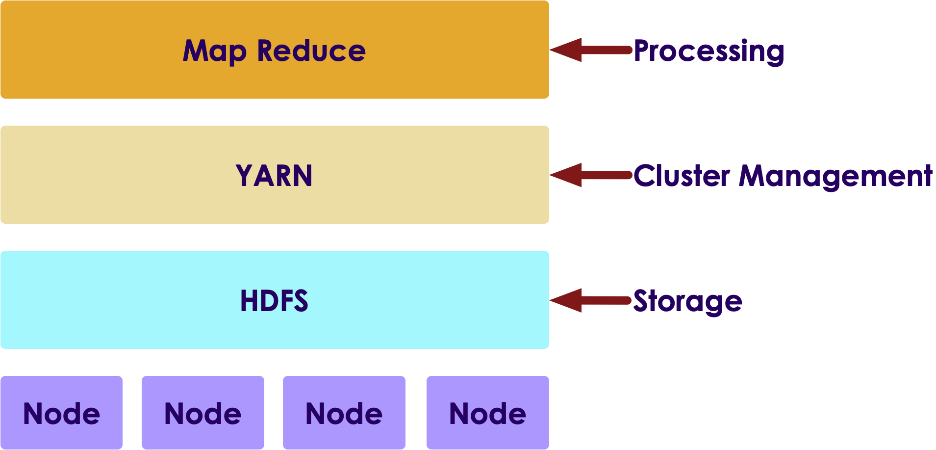
Big Data V1: Hadoop
Hadoop was the first Big Data platform to be widely adopted
Hadoop has three main components
Storage: HDFS - Store huge amount of data in a distributed fashion
Operating System: YARN - manage the cluster
Processing: MapReduce Engine - distributed computing
Copyright © 2022 by Elephant Scale, All Rights Reserved

Slide 5

MapReduce Engine
MapReduce was state of the art around 2008
It was written for a time when
Data was on disk
And most processing was batch
How ever MR had its limitations
It had high overhead
It didn't support 'in-memory' processing
It couldn't do 'streaming / real time' work loads
Copyright © 2022 by Elephant Scale, All Rights Reserved

Slide 6
Spark
Spark is an open Source distributed computing engine
Very fast: On-disk ops are 10x faster than MR
In-memory ops 100x faster than MR
General purpose: MR, SQL, streaming, machine learning, analytics
Hadoop compatible: Runs over Hadoop, Mesos, Yarn, or standalone
Plays nicely with Big Data ecosystem (S3, Cassandra, HBase)
Very easy to use API
"Spark is the First Big Data platform to integrate batch, streaming and interactive computations in a unified framework." - stratio.com
Copyright © 2022 by Elephant Scale, All Rights Reserved

Slide 7
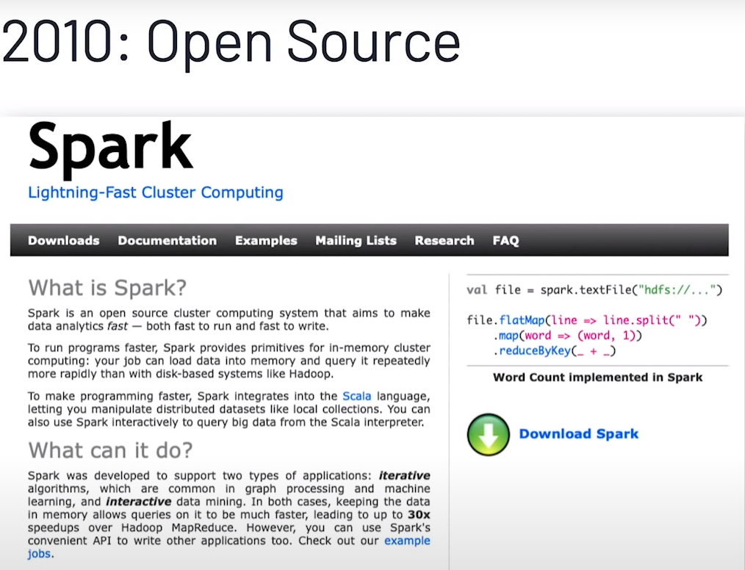

Spark's History
Spark was created at Berkeley AMP Lab around 2009. First open source release 2010
Now top-level Apache project
Databricks
- Supporting and developing Spark
Founded by Spark's creators
Employs the most active committers
Spark is now included with most modern Hadoop distributions
Nice video of Spark's history - from Spark + AI Summit 2020
Copyright © 2022 by Elephant Scale, All Rights Reserved

Slide 8
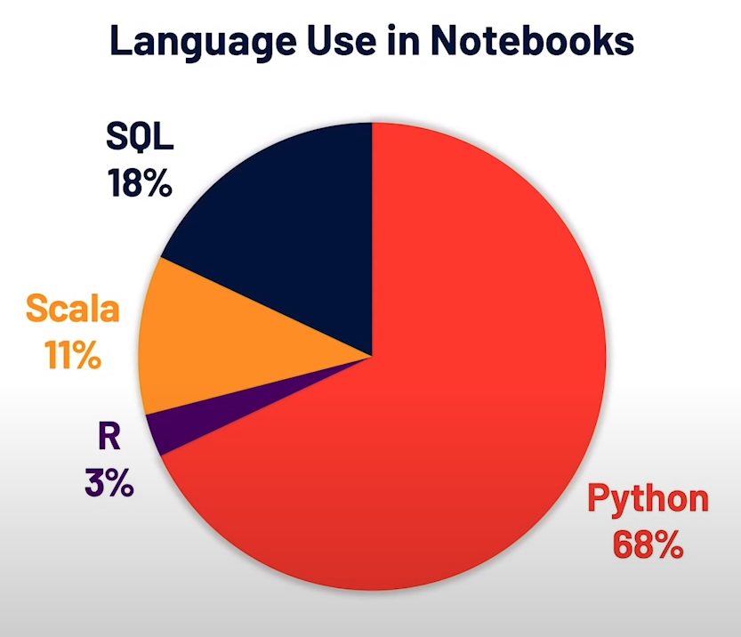
Why is Spark Popular?
Ease of use
Easy to get up and running
Develop on laptop, deploy on cluster
Multiple language support
Java, Scala, Python and R
Developers (Java/Scala), Data Scientists (Python, R)
High performant
Plays nice with BigData eco system
Out of the box functionality
Modern functional programming constructs
Machine Learning / Streaming / Graph processing
Image source and reference
Copyright © 2022 by Elephant Scale, All Rights Reserved

Slide 9
Spark Versions
Version | Release Date | Description
1.0 | 2014-05-30 | Initial Apache release
1.6 | 2016-01-04 | Stable 1.x release
2.0 | 2016-07 | Big update from V1
2.4 | 2020-01 | Stable v2 release
3.0 | 2020 Q2 | V3 release
Copyright © 2022 by Elephant Scale, All Rights Reserved

Slide 10
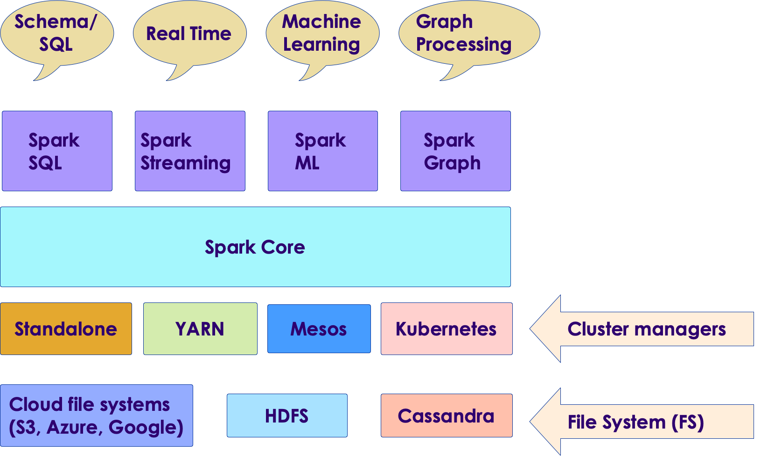
Spark Components
Copyright © 2022 by Elephant Scale, All Rights Reserved

Slide 11
Spark Components
Data Storage: Pluggable data storage systems
Integrates with HDFS, S3, Cassandra DB, and more
Cluster Manager:
Runs Spark on multiple nodes
Provides the distributed execution environment
Works with Mesos, Yarn, Kubernetes, and its own standalone manager
Copyright © 2022 by Elephant Scale, All Rights Reserved

Slide 12
Spark Components: Core
Core has basic building blocks for distributed computing engine
Task schedulers and memory management
Fault recovery (recovers missing pieces on node failure)
Storage system interfaces
Copyright © 2022 by Elephant Scale, All Rights Reserved

Slide 13
Spark Components
Spark SQL:
Analyze structured data using SQL
Spark Streaming:
Process live streams of data in real-time
Low latency, high throughput (1000s events per second)
Spark ML:
Machine Learning at scale
Classification/regression, collaborative filtering
GraphX / GraphFrames:
Graph manipulation, graph-parallel computation
Social network friendships, link data
Copyright © 2022 by Elephant Scale, All Rights Reserved

Slide 14
Spark is a Unified Stack
Spark support multiple programming models
MapReduce style batch processing
Streaming/real-time processing
Querying via SQL
Machine learning
Graph Processing
All modules are tightly integrated; Facilitates rich applications
Spark can be the only stack you need!
Copyright © 2022 by Elephant Scale, All Rights Reserved

Slide 15
Spark Use Cases
Spark Intro Spark Use Cases Spark and Hadoop Running Spark Spark 3 Hands on With Spark
Copyright © 2022 by Elephant Scale, All Rights Reserved

Slide 16


Spark Use Cases
Netflix
Recommendations using Spark + Cassandra
Analyzes streaming events (450 billion events per day)
Personalization through recommendations
Sources: 1 , 2
Starbucks
30,000+ stores generate Petabyte scale data
1000+ data pipelines in Spark
Large scale machine learning using Spark
Stack: Azure cloud + Spark + Delta Lake
Source
More case studies @ BigDataUseCases.Info
Copyright © 2022 by Elephant Scale, All Rights Reserved

Slide 17


Spark Use Cases
Teralytics
Processing cell phone events
180 billion events per day
Spark + HDFS
Estimating usage patterns to enhance coverage (sporting events, commuting, etc.)
Source: 1 , 2
Yahoo
News personalization
120 line Scala program with ML lib replaced 15,000 lines of C++
Spark took 30 minutes to run on 100 million samples
Source
Copyright © 2022 by Elephant Scale, All Rights Reserved

Slide 18
More Spark Use Cases
CERN
Genomics
Time series
Checkout customer success strories at Databricks
Copyright © 2022 by Elephant Scale, All Rights Reserved

Slide 19



Spark at Large Scale
Tencent (Social network in China)
8000 nodes
400 TB+ data
Alibaba (largest e-commerce site in China)
1 PB scale processing
Large scale image processing
Streaming @ Jenelia Farm
1 TB per hour
Analyze medical images
Copyright © 2022 by Elephant Scale, All Rights Reserved

Slide 20
Spark and Hadoop
Spark Intro Spark Use Cases Spark and Hadoop Running Spark Spark 3 Hands on With Spark
Copyright © 2022 by Elephant Scale, All Rights Reserved

Slide 21
Spark and Hadoop Timeline
Hadoop | Year | Spark
Created | 2006
 | 2009 | Starts at AMP lab
 | 2010 | Open sourced
Version 1 | 2011
Version 2 | 2013
 | 2014 | Version 1, Apache top level project
 | 2016 | Version 2
Version 3 | 2019
 | 2020 | Version 3
Copyright © 2022 by Elephant Scale, All Rights Reserved

Slide 22
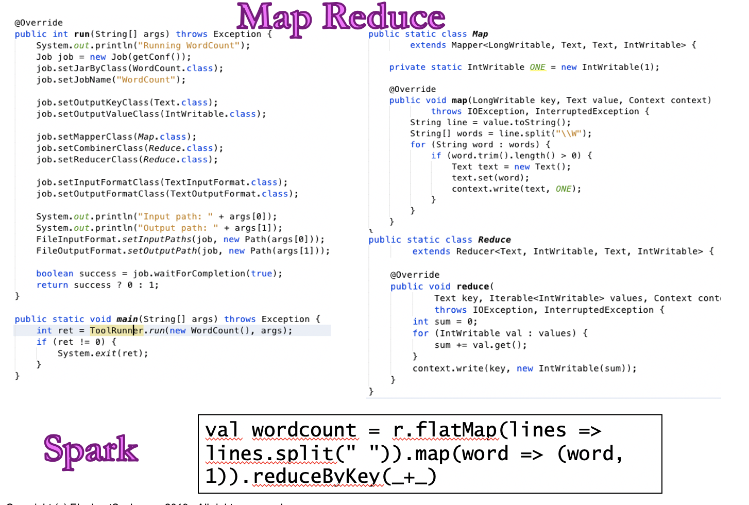
Spark vs. MapReduce
Copyright © 2022 by Elephant Scale, All Rights Reserved

Slide 23
Spark vs. MapReduce
Spark is easier to use than MapReduce
Friendlier development environment
Interactive shells allow faster development
Web based UI notebooks allow easier development
Multiple language support: Java, Python, Scala, R
Spark is high performant than MR
Copyright © 2022 by Elephant Scale, All Rights Reserved

Slide 24
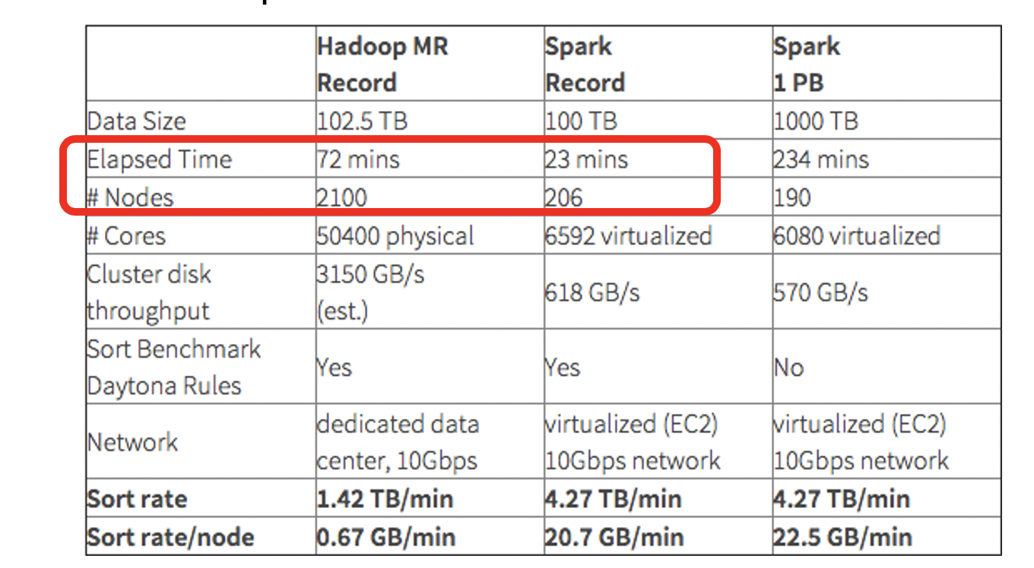
Spark vs. MapReduce Benchmark
Daytona Grey Benchmark: Sort 100TB of data
References:
Databricks blog
http://sortbenchmark.org/
Copyright © 2022 by Elephant Scale, All Rights Reserved

Slide 25
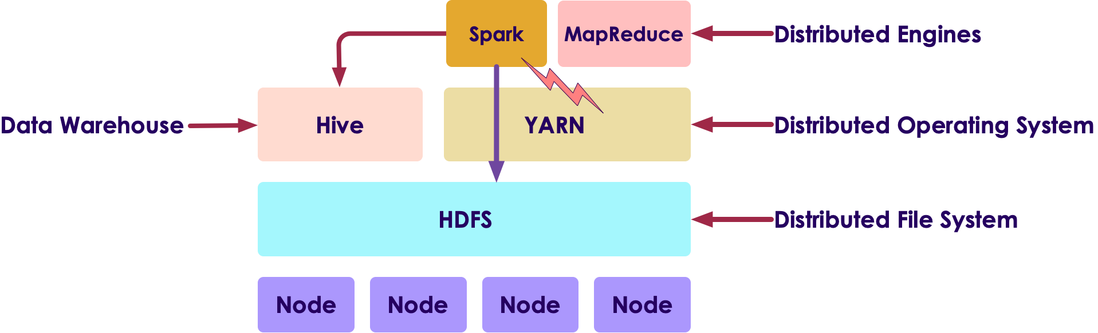
Spark and Hadoop
Hadoop is a Data Platform comprised of:
HDFS: File system
YARN: Cluster manager
Hive: Data warehouse
Engines: MapReduce, Spark
Spark and Hadoop work well together
Spark can utilize HDFS distributed data
Copyright © 2022 by Elephant Scale, All Rights Reserved

Slide 26
Running Spark
Spark Intro Spark Use Cases Spark and Hadoop Running Spark Spark 3 Hands on With Spark
Copyright © 2022 by Elephant Scale, All Rights Reserved

Slide 27
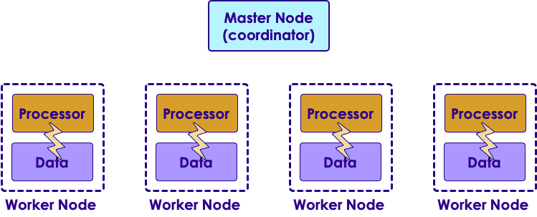
Spark is a Distributed Engine
Spark is distributed / cluster system
Runs on many nodes to achieve scaling
Spark has been demonstrated to scale to thousands of nodes!
Spark is a Master-Worker architecture
Master plays coordinator role
Workers perform computation
Copyright © 2022 by Elephant Scale, All Rights Reserved

Slide 28




Spark Runtimes
On-Premise
Spark is part of most modern Hadoop distributions
Spark can also be downloaded and installed as a standalone system
Hosted solutions
Databricks cloud - hosted Spark platform
Cloud vendors: Amazon, Azure, Google
Copyright © 2022 by Elephant Scale, All Rights Reserved

Slide 29
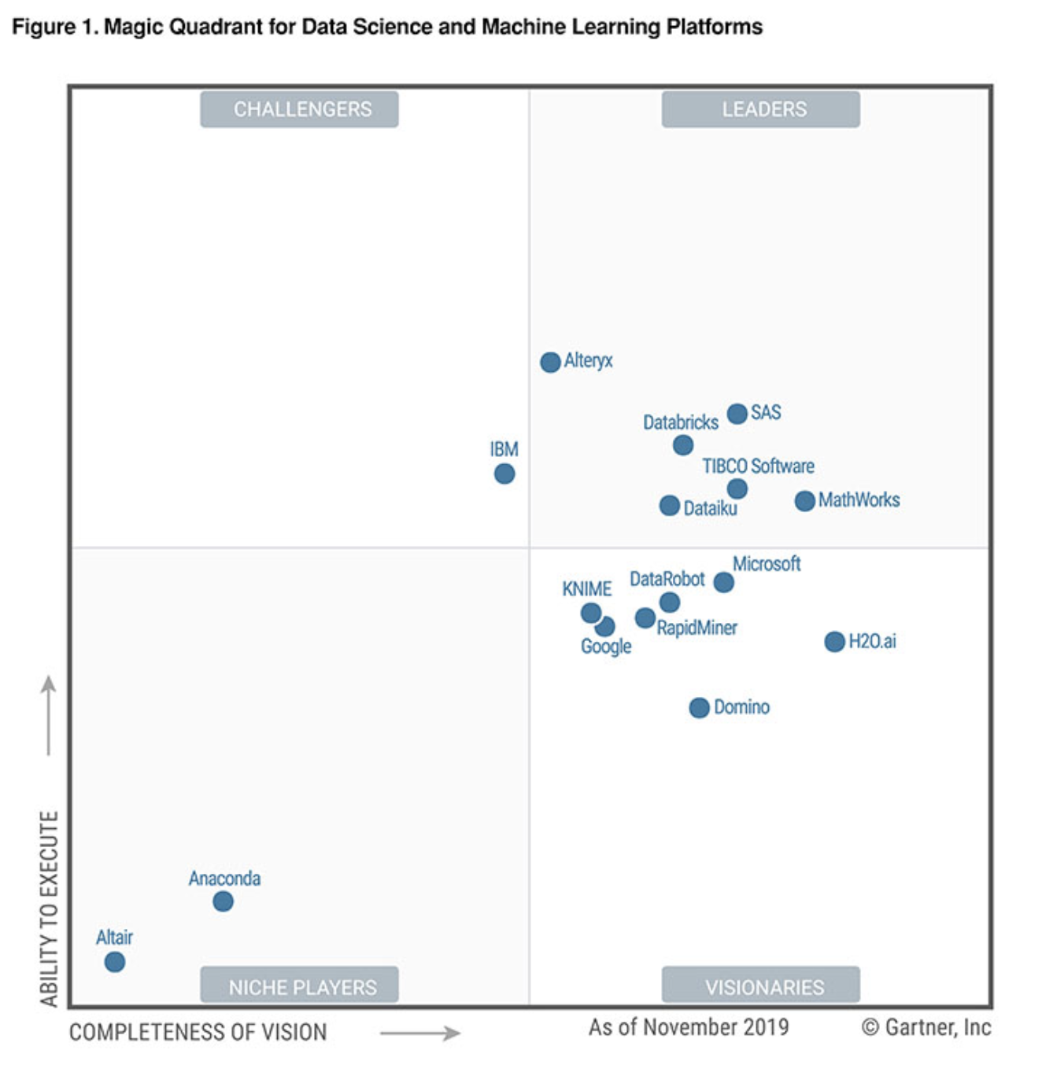
Databricks
Founded by Spark's founders
Develops majority of Spark platform and offers commercial support
Also provides hosted Spark platform ( Databricks Cloud )
Databricks is recognized as a leading provider for Data Analytics and Machine Learning platform (Source: Gartner report )
Copyright © 2022 by Elephant Scale, All Rights Reserved

Slide 30
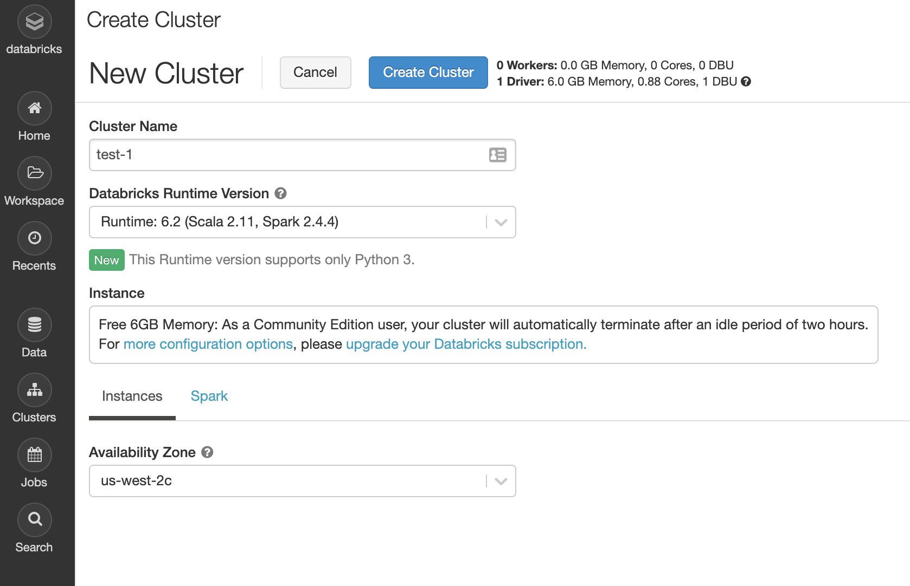
Databricks Cloud
A hosted platform of Spark
Zero maintenance
Auto scale based on work loads
Community edition is free
A single node with 6GB memory
Notebook environment
https://community.cloud.databricks.com/
Copyright © 2022 by Elephant Scale, All Rights Reserved

Slide 31
Spark in the Cloud
Spark is pretty well supported on all major cloud platforms
Basic idea:
Upload data into Cloud storage
Spin up on-demand Spark cluster to process your data
Shutdown when done
Pay for use of compute and storage
Amazon offers Elastic Map Reduce (EMR) that includes Spark
Google has DataProc that provisions Spark clusters
Azure has HDInsight * that includes Spark
Copyright © 2022 by Elephant Scale, All Rights Reserved

Slide 32
System Requirements
Operating system
Development: Windows, Mac, Linux
Deployment: Linux
Languages:
Spark 3: JDK 11, Scala 2.12+, Python 3
Spark 2: JDK 8 or 11, Scala 2.11, Python 2 or 3
Hardware
Resource | Development | Production
CPU | 2+ core | 12+ core
Memory | 4+ G | 256+ G
Disk | - Single spindle - Few gigs | - Multiple spindles - Several Terabytes per node
Copyright © 2022 by Elephant Scale, All Rights Reserved

Slide 33
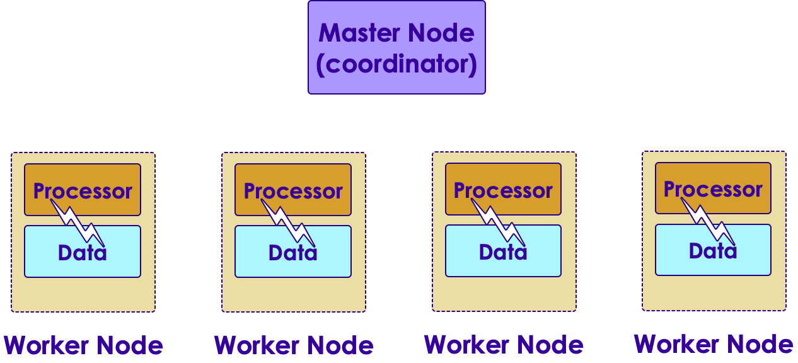
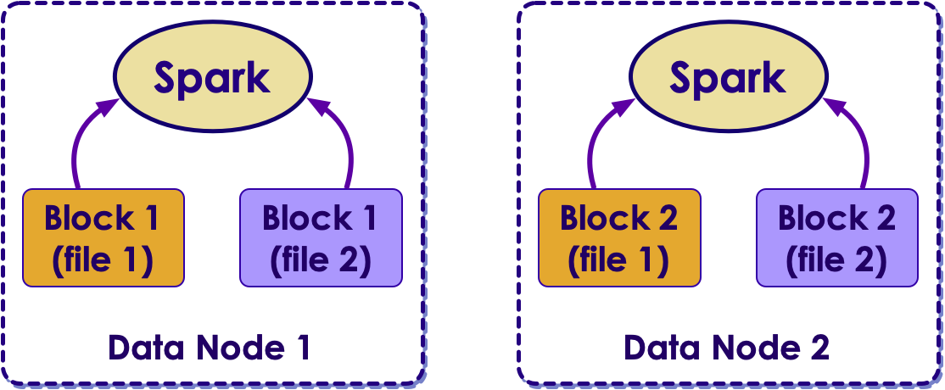
Scaling on Hadoop (On Premise)
Hadoop achieves scale by co-locating data and compute
So applications running on Hadoop cluster, mostly process local data (aka data locality )
Pros:
Works well on on-prem architecture (1G-10G networks)
Very fast processing, because of data locality
Cons:
The cluster size is fixed; very hard to scale up/down dynamically based on demand
Copyright © 2022 by Elephant Scale, All Rights Reserved

Slide 34
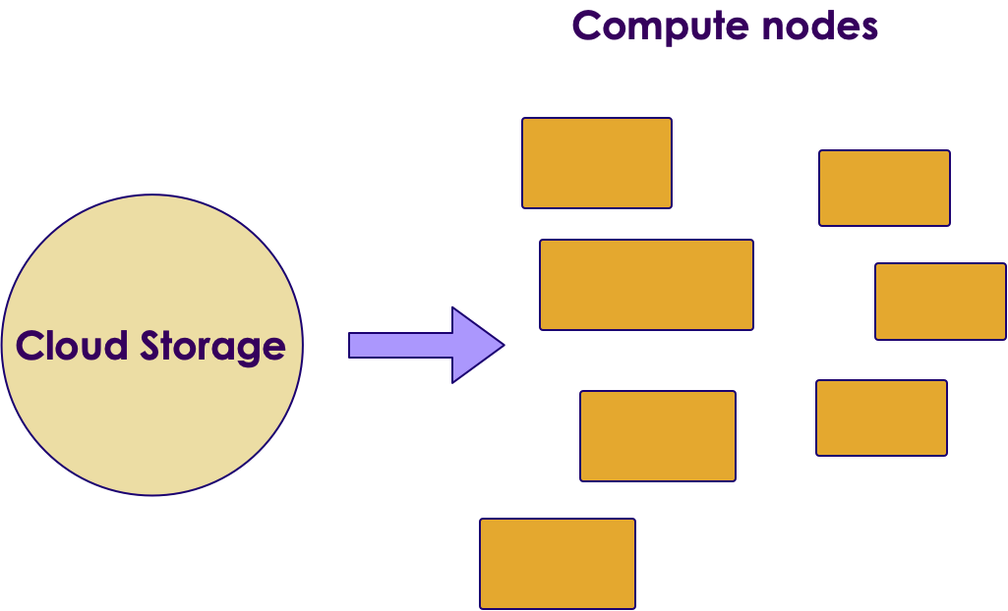
Spark Scaling on the Cloud
In Cloud architecture, storage and compute are separate!
Compute nodes stream data from storage (called buckets)
For this to work, compute nodes and storage must have ultra high speed network
Google built the next gen network for their data centers using custom hardware, software, network switches ( source )
It can deliver more than 1 Petabit/sec of total bisection bandwidth.
To put this in perspective,
enough for 100,000 servers to exchange information at 10Gb/s each
enough to read the entire scanned contents of the Library of Congress in less than 1/10th of a second
Copyright © 2022 by Elephant Scale, All Rights Reserved

Slide 35
Spark Scaling on the Cloud
Pros:
Gives a lot of flexibility on scaling and scheduling computes
Can dynamically scale compute capacity up/down
Leverages massive infrastructure the cloud vendors have
Implemented by cloud vendors / hosted platforms
Cons:
Not easily implemented on-prem/in-house
Need to be on a cloud environment
Costs can add up for storage and compute
Copyright © 2022 by Elephant Scale, All Rights Reserved

Slide 36
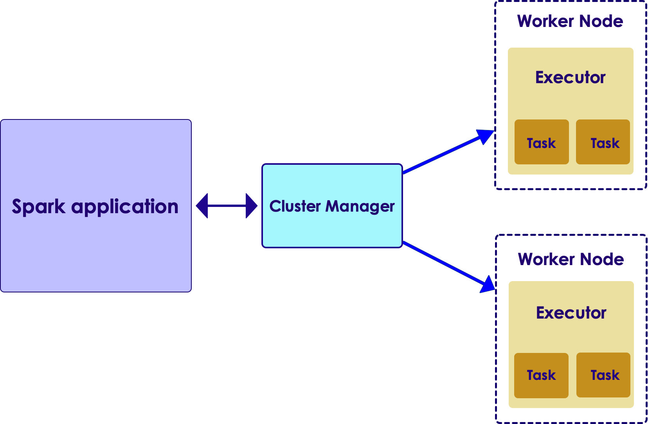
Running a Spark Job
When a Spark application is launched, the following things happen:
Spark talks to the cluster manager (CM) , to request resources
CM allocates resources for the Spark application
Spark then distributes the code to worker nodes
Executors on worker nodes start computing
Each Executor can employ multiple tasks to parallelize the work
Copyright © 2022 by Elephant Scale, All Rights Reserved

Slide 37
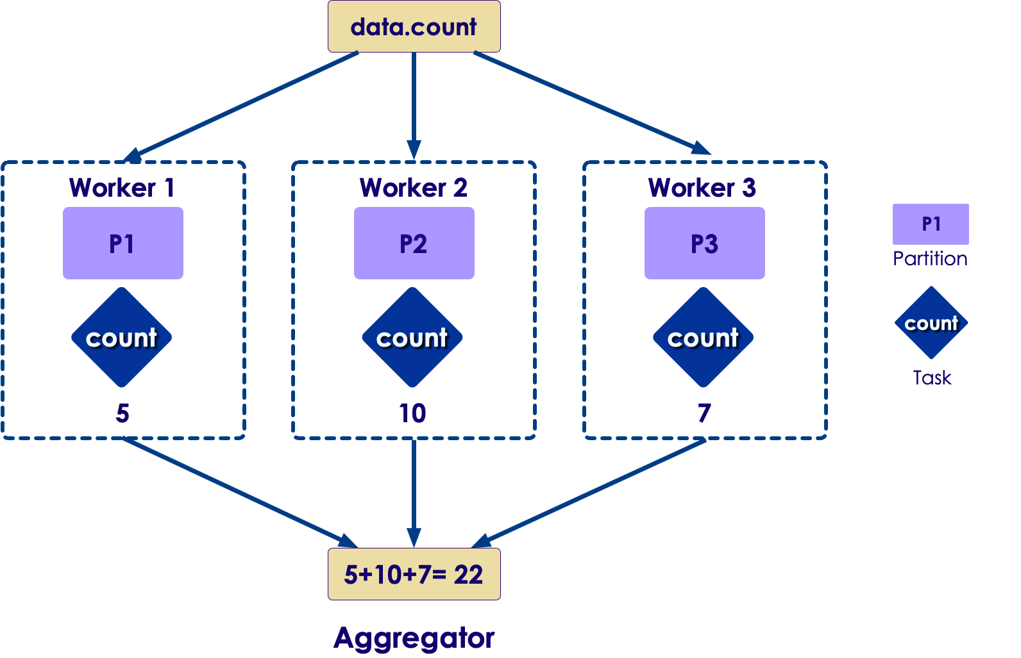
Parallelizing Computations
Here is a simple example of doing a COUNT in a distributed way
Each worker computes the count for the data it has
And then an 'aggregator (reducer)' combines the results from multiple workers to produce a final count
Machine learning computations are more complex; But Spark handles the parallelism
Copyright © 2022 by Elephant Scale, All Rights Reserved

Slide 38
Spark 3
Spark Intro Spark Use Cases Spark and Hadoop Running Spark Spark 3 Hands on With Spark
Copyright © 2022 by Elephant Scale, All Rights Reserved

Slide 39
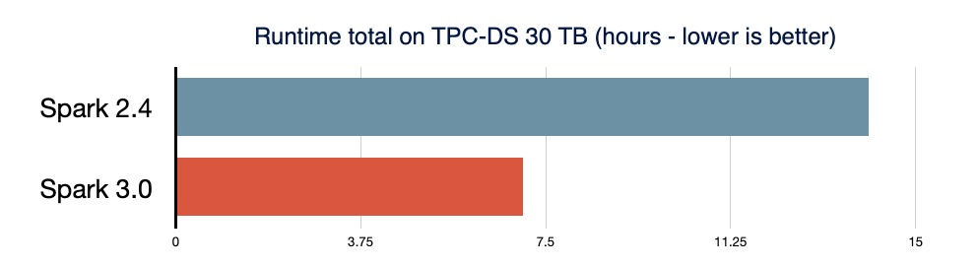
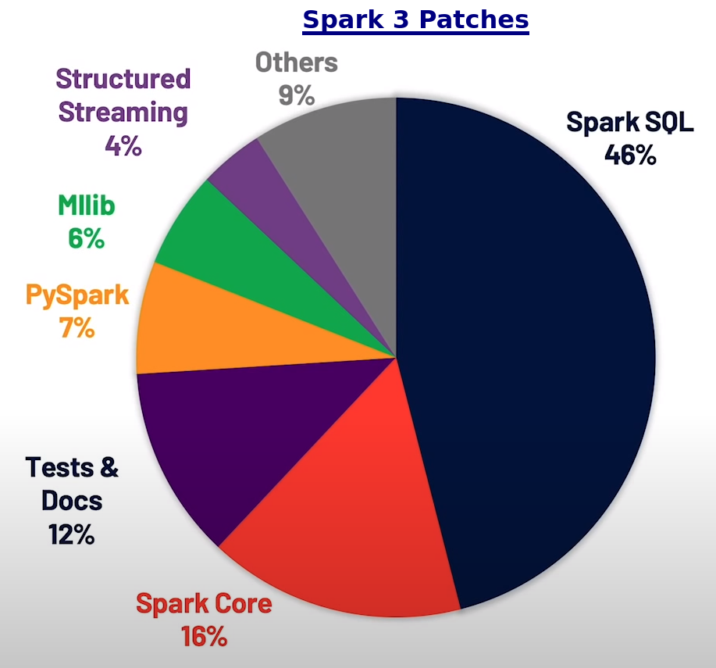
Spark 3
Spark 3 is a big release; 2020 Q3
Performance focused
Over 3400+ patches (alost half of them for Spark SQL)
Easy to switch from 2.x
Spark 3 features:
Delta Lake
Spark SQL improvements (adaptive query execution)
Better python performance
Better Structured Streaming + metrics
More on these in the next slides
References
Spark Summit 2020 Keynote - Spark 3
Introducing Apache Spark 3.0 - blog
Spark 3.0 Features with Examples
Copyright © 2022 by Elephant Scale, All Rights Reserved

Slide 40
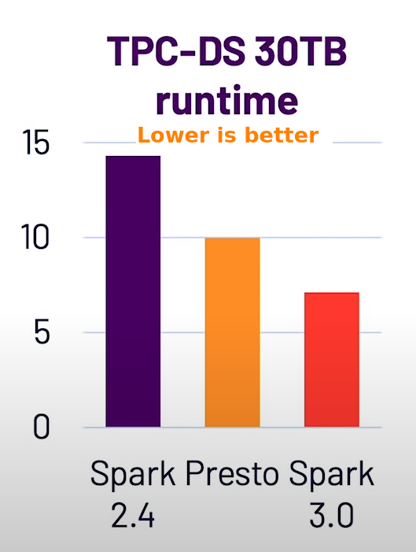
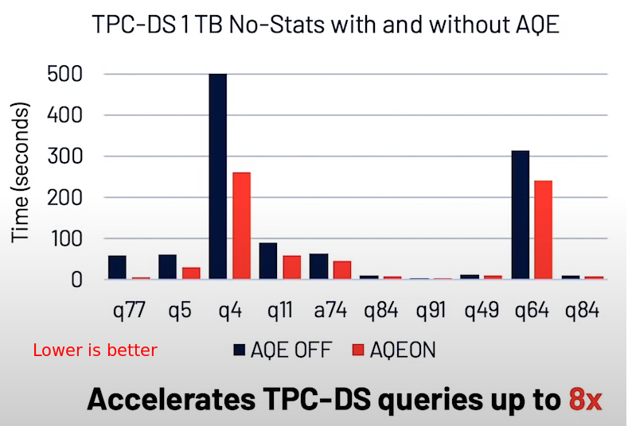
Spark 3 SQL Improvements
Spark SQL is very widely used
Spark has one of the best SQL engines around
ANSI SQL support improved
Adaptive Query Execution (AQE) :
Can adjust execution plan at runtime (change number of reduces ..etc)
Can even observe data skew and make changes (This is a big deal, as it happens a lot in real life workloads)
Can do effective joins automatically
Source
Copyright © 2022 by Elephant Scale, All Rights Reserved

Slide 41
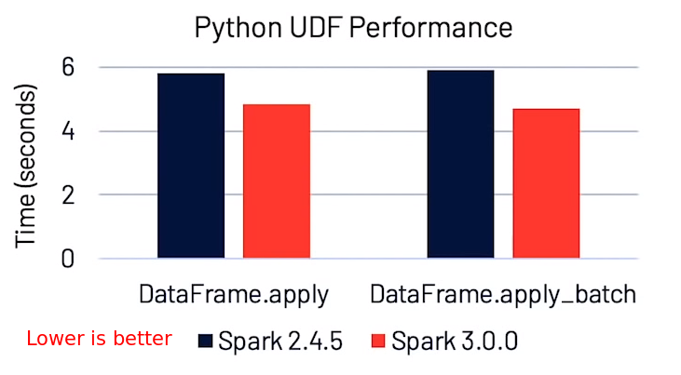
Spark 3 Python Improvements
New APIs for Pandas function
Faster Apache Arrow based calls to Python user code
Apache Arrow is a language-independent columnar memory format, for efficient operations on modern hardware like CPUs and GPUs.
Also supports zero-copy reads for lightning-fast data access without serialization overhead.
UDFs (User Defined Functions) are easier to write and perform better
Source
Copyright © 2022 by Elephant Scale, All Rights Reserved

Slide 42
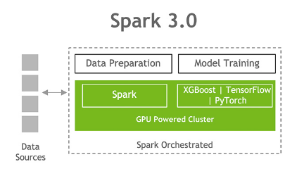
Spark 3 and GPU
Spark 3 recognizes GPUs as a first-class resource along with CPU and system memory
So Spark can place GPU-accelerated workloads directly onto servers containing the necessary GPU resources
Operations on Dataframes, Spark SQL and Spark ML can utilize GPU
NVIDIA Rapids library enables GPU acceleration for Spark
References:
NVIDIA page on Spark + GPU
Get free ebook on Spark + GPU
Copyright © 2022 by Elephant Scale, All Rights Reserved

Slide 43


Spark Ecosystem Projects
Koalas : Pandas API over Spark
Delta Lake - Reliable, transactional table storage for Big Data
Scikit Learn on Spark Run ML algorithms from Scikit Learn library on Spark
Spark Rapids - GPU acceleration
Data-fu Spark - A good collection of UDFs for Spark
MLFLow - Manage machine learning lifecycle
More
Copyright © 2022 by Elephant Scale, All Rights Reserved

Slide 44
Delta Lake
Delta Lake is an implementation of modern Data Lake
Features:
Fully atomic operations
Transactions are supported
Scalable to massive amount of data
For more details see Delta-Lake section
Copyright © 2022 by Elephant Scale, All Rights Reserved

Slide 45
Future of Spark
Project Zen - Improve Python usability and Spark
Continue improving Spark SQL Adaptive Query Execution (AQE) engine
Continue improving ANSI SQL compliance
Copyright © 2022 by Elephant Scale, All Rights Reserved

Slide 46
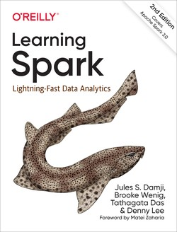
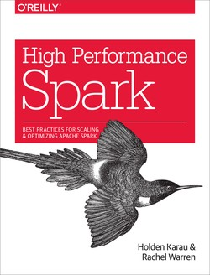
Further Reading
Learning Spark - 2nd edition by Jules S. Damji, Brooke Wenig, Tathagata Das, Denny Lee
High Performance Spark by Holden Karau, Rachel Warren
Spark - 10 years - from Spark + AI Summit 2020
Databricks blog - keep up with latest Spark news
Copyright © 2022 by Elephant Scale, All Rights Reserved

Slide 47
Hands on With Spark
Spark Intro Spark Use Cases Spark and Hadoop Running Spark Spark 3 Hands on With Spark
Copyright © 2022 by Elephant Scale, All Rights Reserved

Slide 48

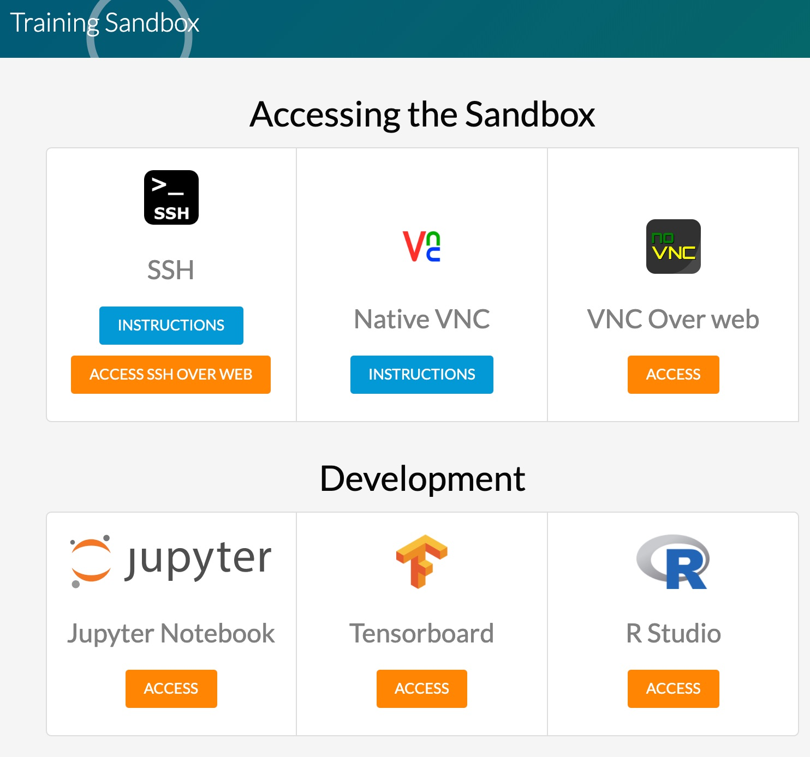
Lab: Access Lab Environment
We can use either
training VMs in the Cloud
or Databricks community cloud
If using training VMs
Allocate VMs to students in class
Point them to IP address of the machine
Access the IP address in a browser
Make sure they can see the sandbox splash page
Copyright © 2022 by Elephant Scale, All Rights Reserved

Slide 49
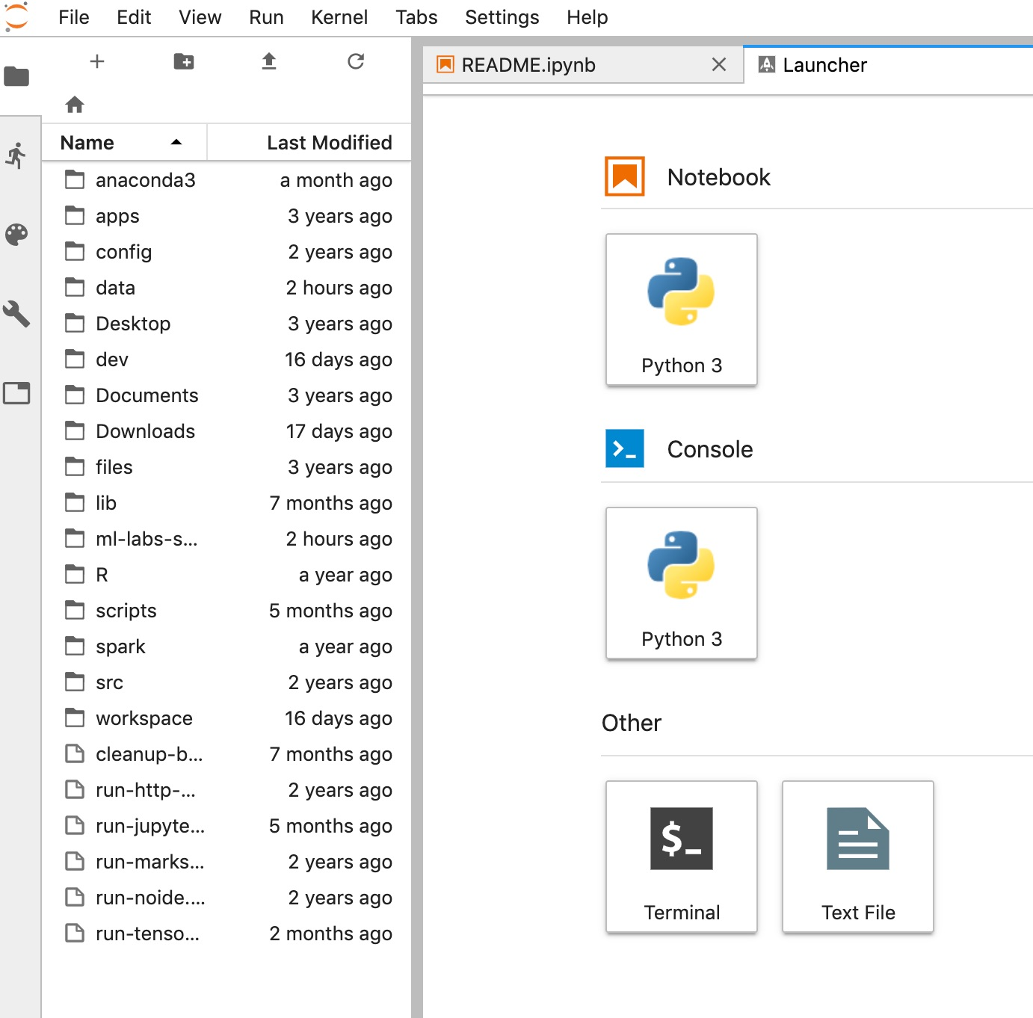
Lab: Test Jupyter + Spark UI
Access Jupyter Labs
Access Spark Master UI
If accessing services don't work, it is highly likely a network issue. Try the following
Try proxy access button
Disable any VPN software on student's laptop
Connect to 'guest' network
Try connecting via 'mobile hotspot'
Copyright © 2022 by Elephant Scale, All Rights Reserved

Slide 50
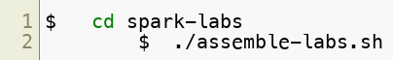
Lab: Distribute Lab Bundle
To instructor:
create a lab bundle
This will create a zip file ( labs.out/spark-labs.zip )
Distribute this bundle to students
Upload it to Google drive or Amazon S3
Explain the difference between .md, .ipynb, .html files
To students
You can open html files in browser to see lab instructions
If you have Jupyter environment setup, you can run __ ./run-jupyter.sh __ and view the notebooks
Copyright © 2022 by Elephant Scale, All Rights Reserved

Slide 51

Lab: Lab Setup
Overview:
Setting up the labs
Approximate time:
5 mins
Instructions:
SETUP-1: instructions in the lab bundle
Copyright © 2022 by Elephant Scale, All Rights Reserved

Slide 52
Lab: Testing123
Overview:
Testing the environment
Approximate time:
5 mins
Instructions:
Testing123
Copyright © 2022 by Elephant Scale, All Rights Reserved

Slide 53
Lab: First Look at Spark
Overview:
We will get started with Spark
Approximate run time:
20-30 mins
Instructions:
Start-1 : First look at Spark (lab 2.1)
Copyright © 2022 by Elephant Scale, All Rights Reserved

Slide 54


Review and Q&A
Let's go over what we have covered so far
Any questions?
Copyright © 2022 by Elephant Scale, All Rights Reserved

